Slide 1
Covid-19 Impact on Vehicle Sales in 2020-2023 Stephanie Roethlisberger Dustin Sheets TJ Davis Juliana Cortes Arnold Vincent
The objective of this study is to analyze the impact of the COVID-19 pandemic on the SALES of used and new vehicles in the market from 2020 to 2023. We are looking at how the pandemic and its related economic effects influenced consumer behavior, vehicle demand, and market trends in the automotive industry during this period.

Slide 2
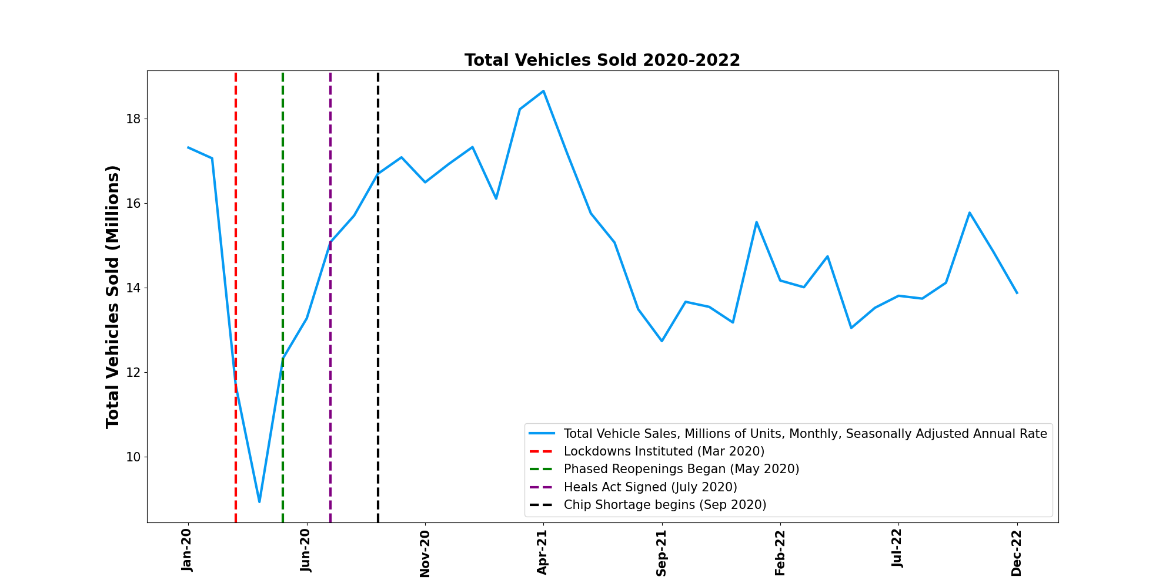
How were vehicle sales affected between Jan 2020 and Dec 2022?
Units sold declined 20%

Slide 3
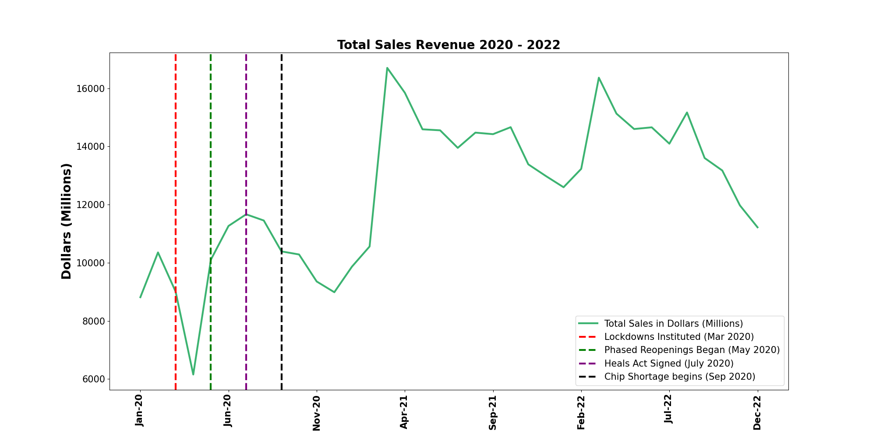
How did Sales Revenue Change?
Total Revenue rose 27%

Slide 4
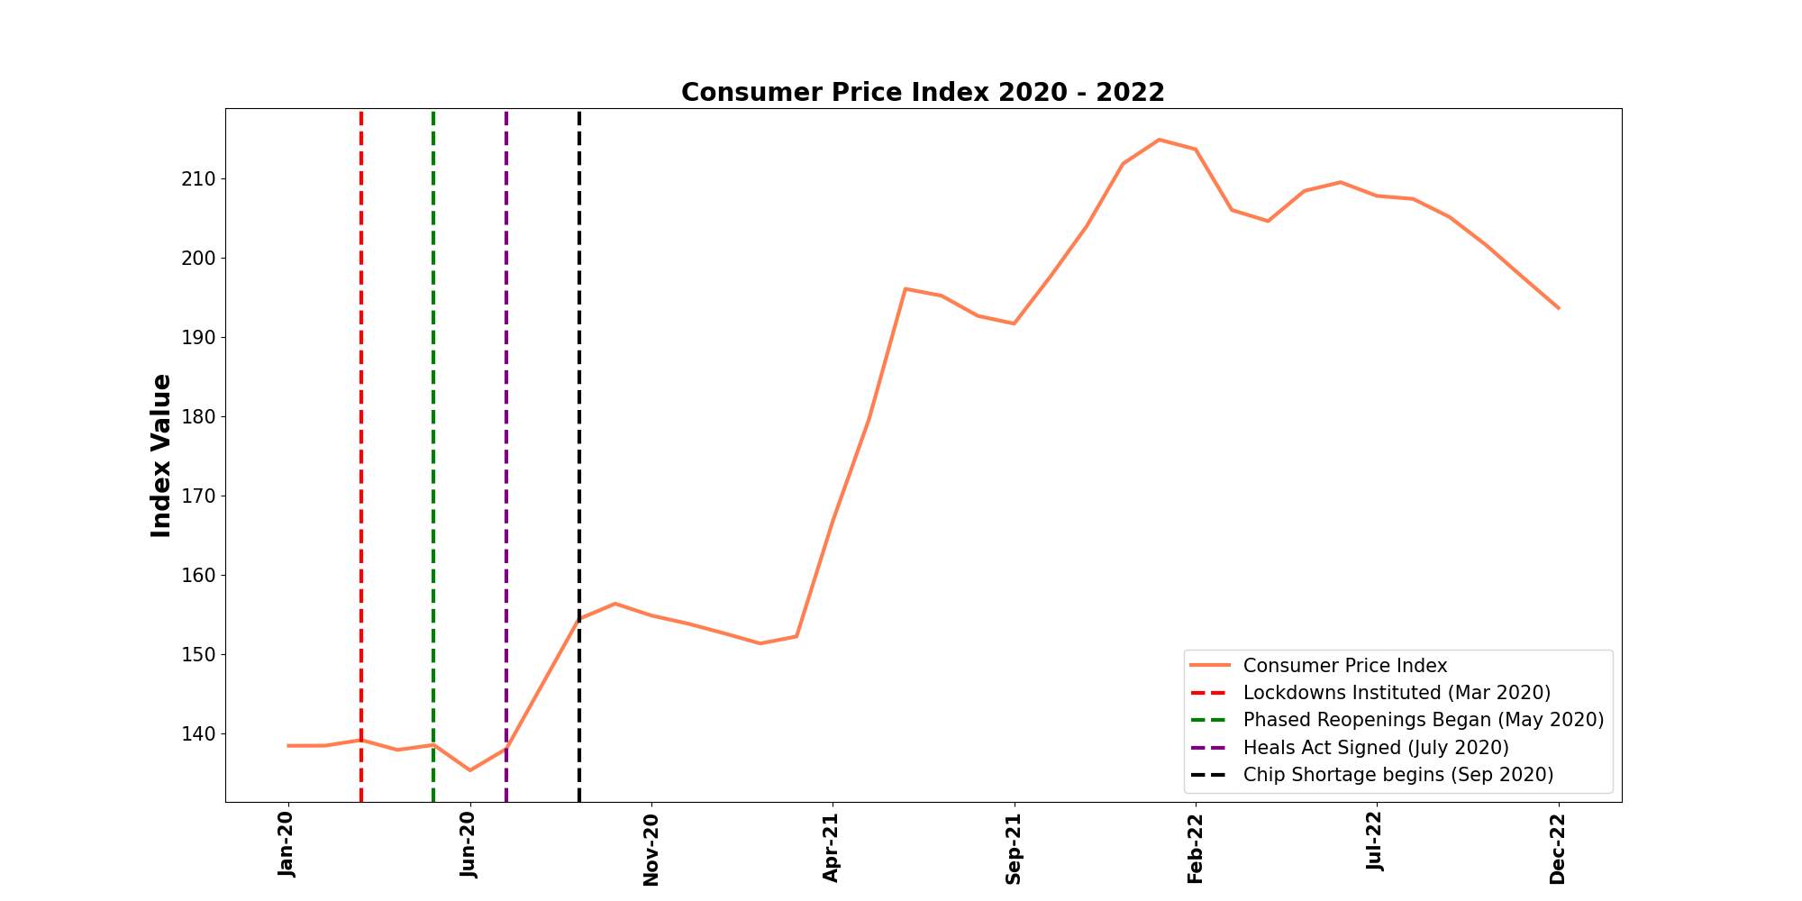
Were overall prices affected?
CPI rose 40%

Slide 5
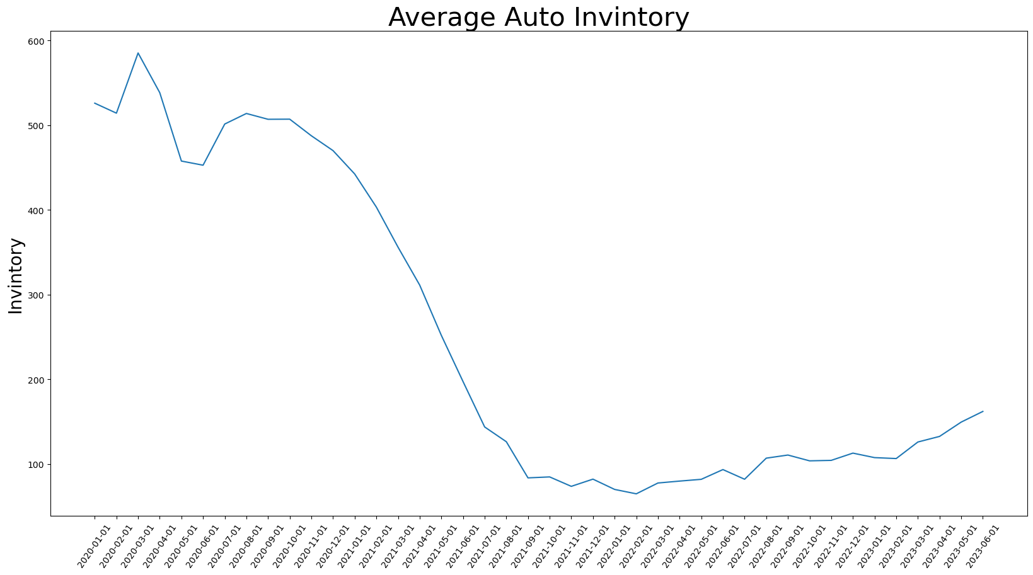
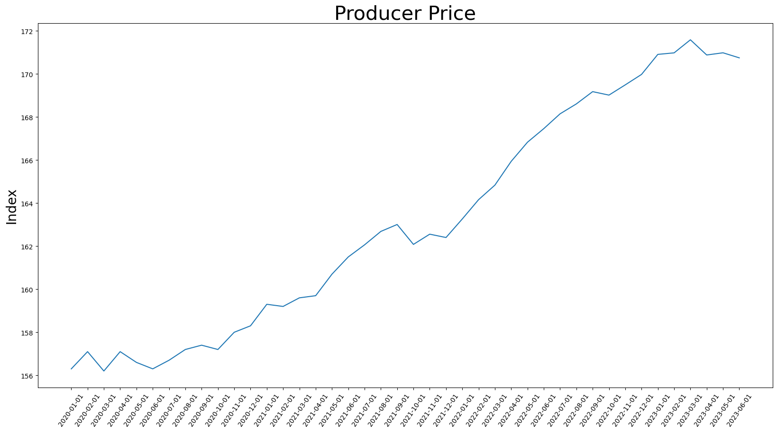
Why did prices increase?
I was able to find a -0.82 correlation between the producer price and the Inventory.

Slide 6
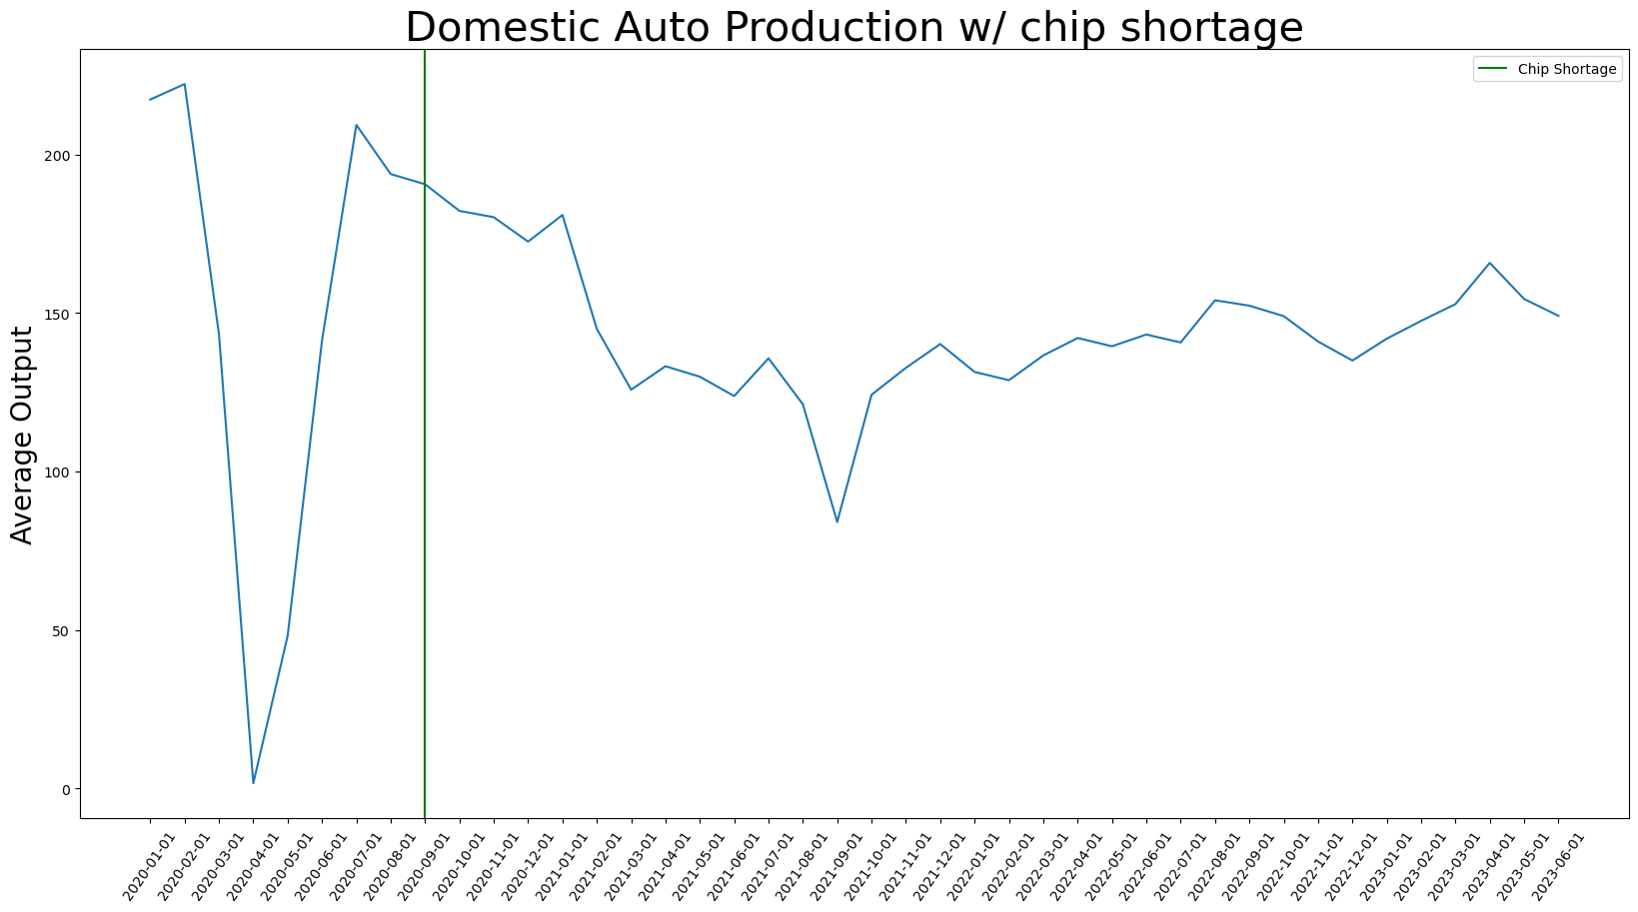
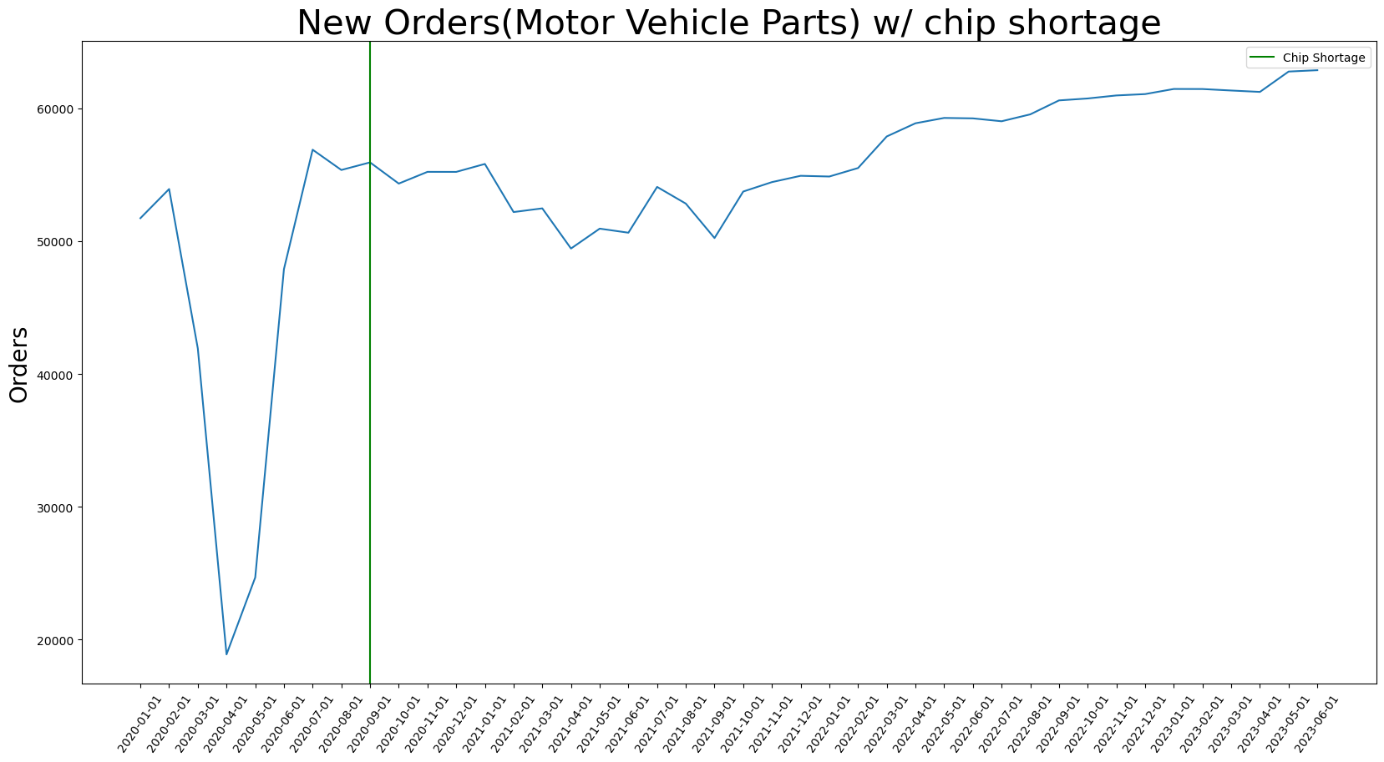
Less cars being made?

Slide 7
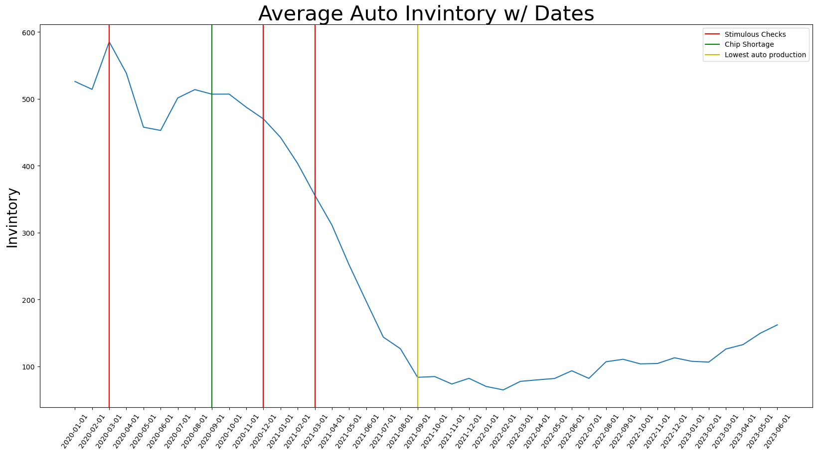
Why did prices increase?

